Slide 1
REGIONAL BARBER OWNERS MEETUP · FALL 2026
Chair Rental Economics That Hold
James Gutierrez · Sharp Line Cuts · 18247 Livernois Ave, Detroit
How to build a base income that doesn't depend on you being in the chair every day.

Slide 2
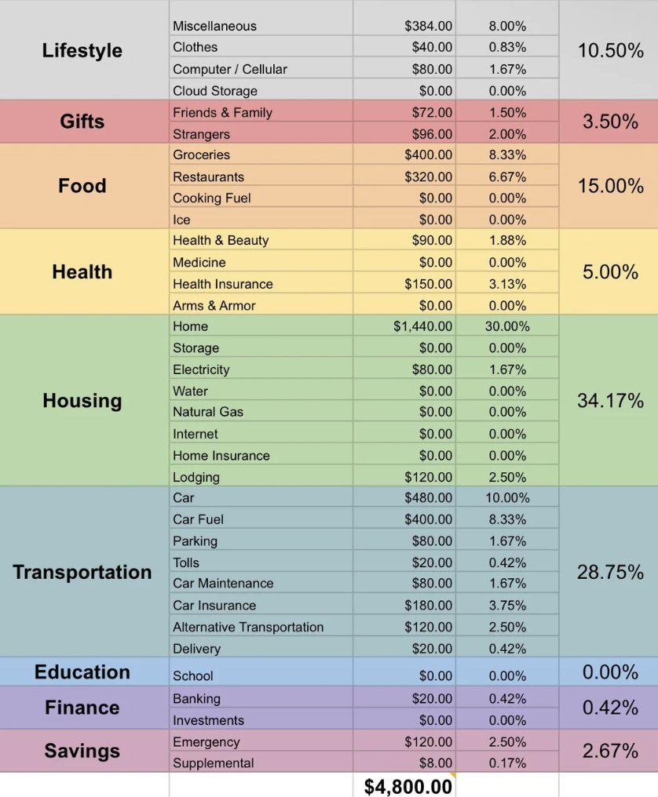
The Chair Rental Model
Two chairs. Two barbers. $275/week each. Simple.
2
Rental chairs
$275/wk
Per chair
$28,600/yr
Annual rental income
Feb 2014
Rental model in place since
Why Chair Rental Works
• Fixed income whether James cuts 30 or 20 clients that week.
• Barbers keep their own clients and build their own book.
• No payroll, no benefits, no scheduling headaches.
• Month to month , easier to scale than adding employees.
• $275/week × 52 weeks = $14,300/year per chair. Two chairs = $28,600.

Slide 3

Owner Income Breakdown
How the numbers stack up at year 12
The Math
Barbering revenue ....... +$58,000
Chair rental (2 × $275 × 52) +$28,600
Business expenses (net) . -$4,600
Net personal income ..... = $82,000
"The rental base means a slow week doesn't become a bad month."

Slide 4
Three Takeaways
01
Protect the base.
The rental income is the floor. Build your personal book on top of it, not instead of it. Never rent a chair to someone who disrupts the floor culture.
02
Train your bench.
Ty Jackson starts as a $0 apprentice. In 2027 he becomes a third rental chair , another $14,300/year. The pipeline IS the business model.
03
Plan in ten-year arcs.
Sharp Line Cuts turns thirteen next February. The McNichols location opens March 27, 2027. Twelve years of showing up is why that is possible.

